Slide 1
Lab 12 : Part 4
Parasitic Worms and Arthropod Vectors

Slide 2
Station 7
Wuchereria bancrofti
Mosquitoes of genera Culex, Aedes and Anopheles can serve as vectors for Wuchereria bancrofti, the filaria worm. This parasitic worm causes filariasis (aka elephantiasis). Inside the mosquito, the microfilariae obtained from a blood meal of an infected human host mature into infective larvae within one to two weeks. During a subsequent blood meal by the mosquito, the larvae in her anticoagulant-loaded salvia infect the new human host. The microfilariae (tiny filarial worm larvae) migrate from the blood to the lymphatic vessels and lymph nodes of the human host, where they mature into adult worms. The adult worms mate and the females release millions of microfilariae into the blood. New mosquitoes pick up these microfilariae when they bite an infected person, so infected people serve as a source of infection to others.
Lymph vessels normally function by draining excess tissue fluids that leaked out of the blood capillary beds. Lymphedema is caused by blockage of the lymph system, resulting in fluid collection and swelling of any extremity; arms, legs, breasts, and genitalia.

Slide 3
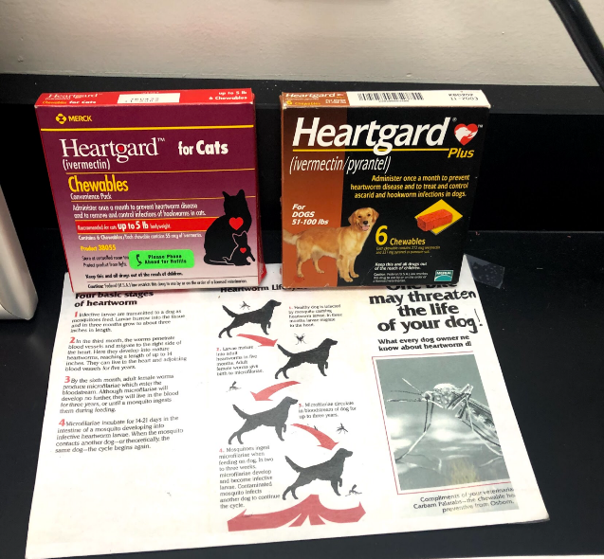
Station 8
Dissected dog heart showing numerous heartworm parasites which block blood flow.

